Slide 1
Consumer and Producer
Chatchai Kongmanee
Specialist Solution Architect
Red Hat, Thailand

Slide 2
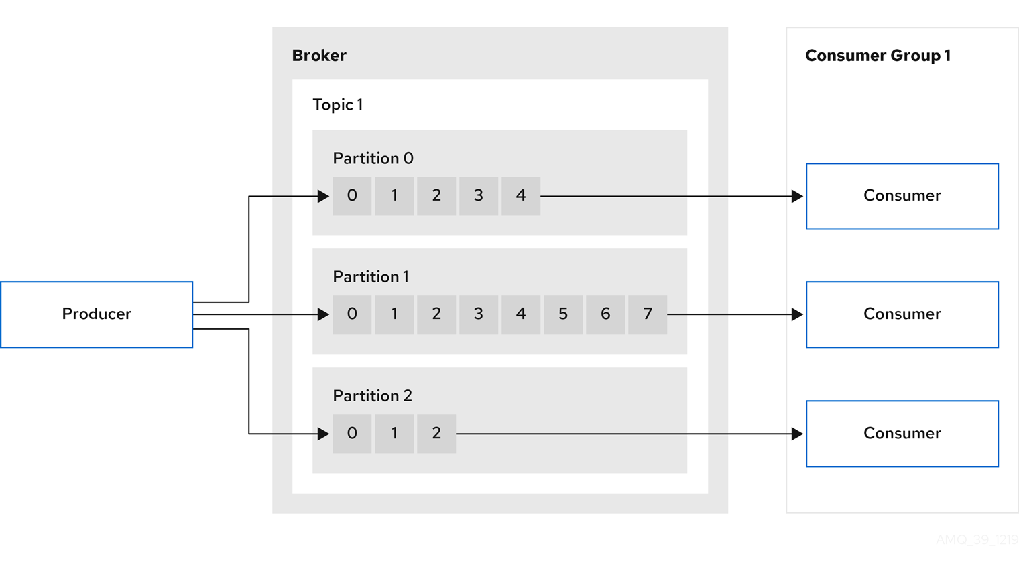
Producer & Consumer
Notes:
The default partitioner follows these rules:
If a producer provides a partition number in the message record, use it.
If a producer doesn’t provide a partition number, but it provides a key, choose a partition based on a hash value of the key.
When no partition number or key is present, pick a partition in a round-robin fashion.
So, you can use the default partitioner in three scenarios:
If you already know the partition number in which you want to send a message record, then use the first rule.
When you want to distribute data based on the hash key, you will use the second rule of the default partitioner.
If you don’t care about in which partition message record will be stored, then you will use the third rule of default partitioner.
There are two problems with the key:
If the producer provides the same key for each message record, hashing will give you the same hash number, but it doesn’t ensure that if you provide two different keys, then it will never give you the same hash number.
The default partitioner uses the hash value of the key and the total number of partitions on a topic to determine the partition number. If you increase a partition number, then the default partitioner will return different numbers evenly if you provide the same key.

Slide 3
Consumer and Producer APIs
Java based clients which are part of Apache Kafka project
Sending and receiving messages
Always up to date Kafka API
Have support for serializing / deserializing objects

Slide 4
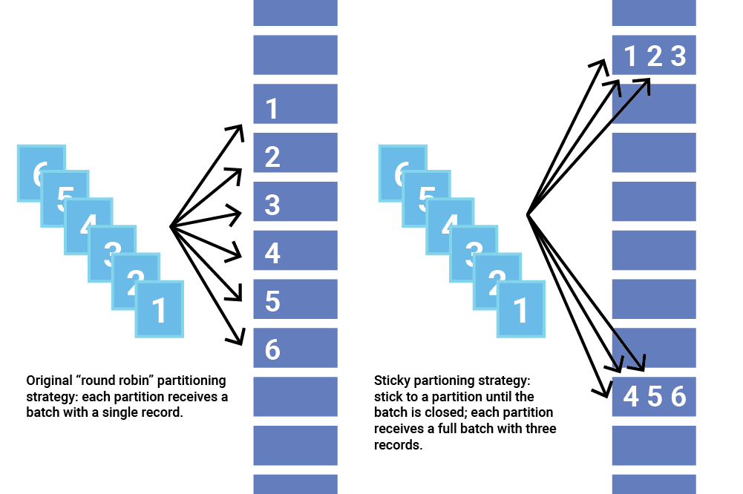
Producers
Destination partition computed on client
Round robin
Specified by hashing the “key” in the message
Custom partitioning (client API)
Writes messages to “leader” for a partition
Acknowledge :
No ack, acks=0
Ack on message written to “leader”, acks=1 (default)
Ack on message also replicated to “in-sync” replicas (min.insync.replicas), acks=all
Notes:
The default partitioner follows these rules:
If a producer provides a partition number in the message record, use it.
If a producer doesn’t provide a partition number, but it provides a key, choose a partition based on a hash value of the key.
When no partition number or key is present, pick a partition in a round-robin fashion.
So, you can use the default partitioner in three scenarios:
If you already know the partition number in which you want to send a message record, then use the first rule.
When you want to distribute data based on the hash key, you will use the second rule of the default partitioner.
If you don’t care about in which partition message record will be stored, then you will use the third rule of default partitioner.
There are two problems with the key:
If the producer provides the same key for each message record, hashing will give you the same hash number, but it doesn’t ensure that if you provide two different keys, then it will never give you the same hash number.
The default partitioner uses the hash value of the key and the total number of partitions on a topic to determine the partition number. If you increase a partition number, then the default partitioner will return different numbers evenly if you provide the same key.

Slide 5
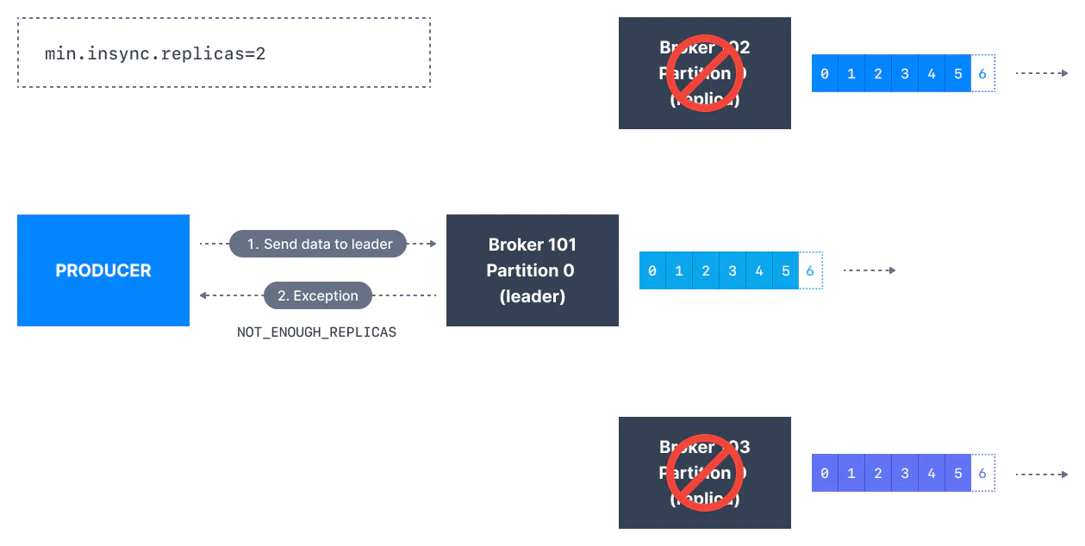
Producer APIs
Produces messages
Create producer
Send messages
Get confirmation
Messages are batched over network where possible
Reliability can be configured
Combination of acks option in producer and min.insync.replicas option in broker
Interceptors can be used to intercept and manipulate messages
Notes:
OnSend, before sent to kafka
OnAcknowledgement, when kafka responds

Slide 6
Producer APIs
You can access this API by using a variety of clients, but the Java client is the only one maintained as part of the main Kafka project.
The Record Abstraction
Topic: The topic where the record is sent.
Partition (optional): The partition where the record is sent. If not provided, then the key field is used to choose the partition.
Key (optional): The identifier of the record. The key is used to choose the partition where the record is sent. Records with the same key are sent to the same partition.
If both partition and key fields are not provided, then the partition is assigned in a round-robin fashion.
Value: The value or payload.
Timestamp (optional): Represents the creation time of the record. If not provided, current time.
Headers (optional) A list of key/value additional information.
A constructor for the ProducerRecord class has the following signature:
ProducerRecord​(String topic, Integer partition, K key, V value, Iterable<Header> headers)

Slide 7
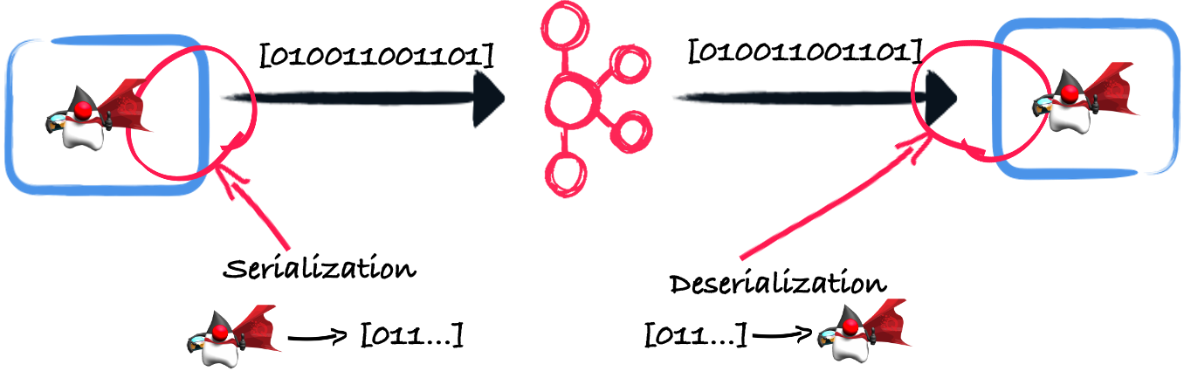
Serializers
transforms an object, or a data structure, into a stream of bytes. (array of bytes)
You serialize when you produce messages and you deserialize (the opposite operation) when you consume messages.
Kafka includes built-in serializers for simple data types (integer, string, float, long…​).
Need Custom serializers for complex data
For example, let's say you have the following class:
Serializers and deserializers implement the org.apache.kafka.common.serialization.Serializer and org.apache.kafka.common.serialization.Deserializer interfaces (respectively).
Producers expect a configuration property named key.serializer to be completed with the serializer class used to send records.

Slide 8
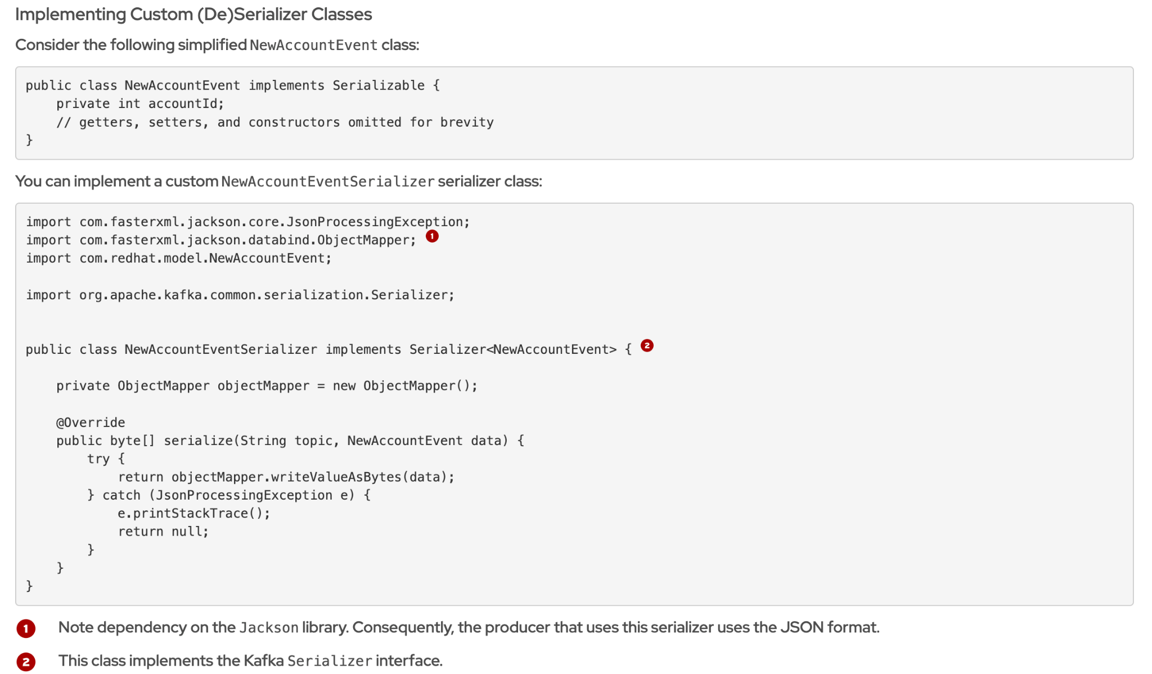
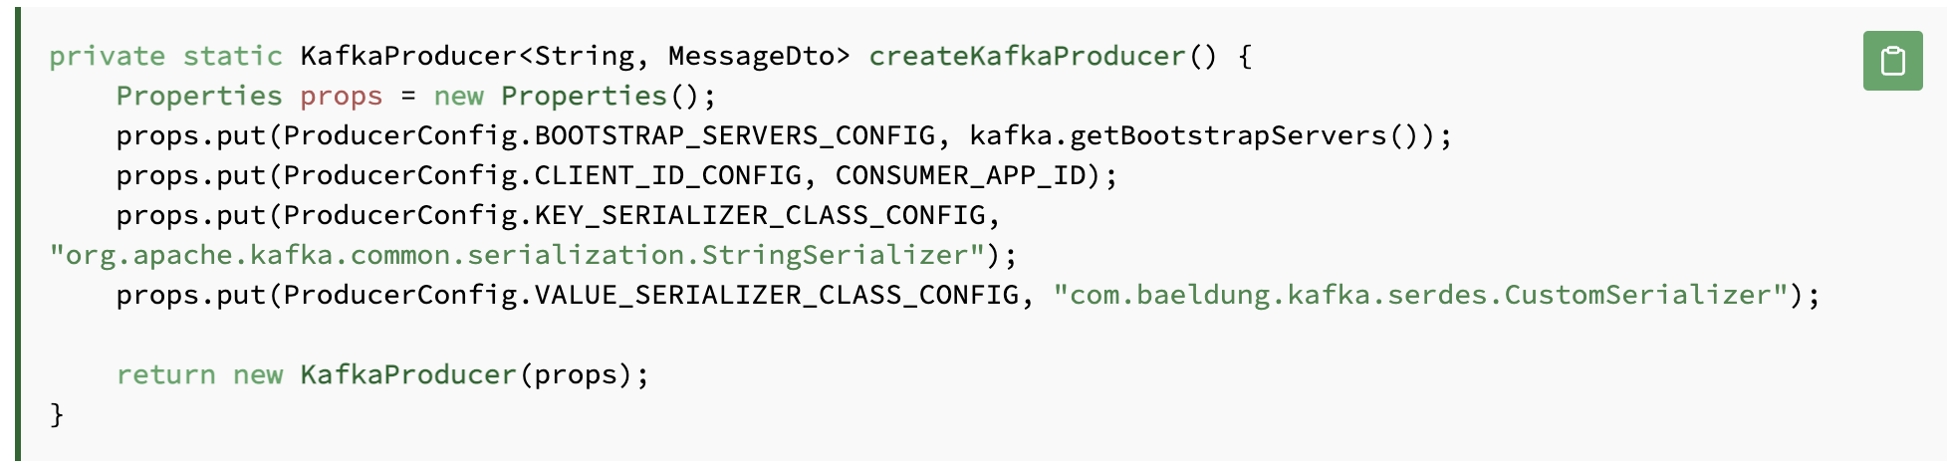
Serializers

Slide 9
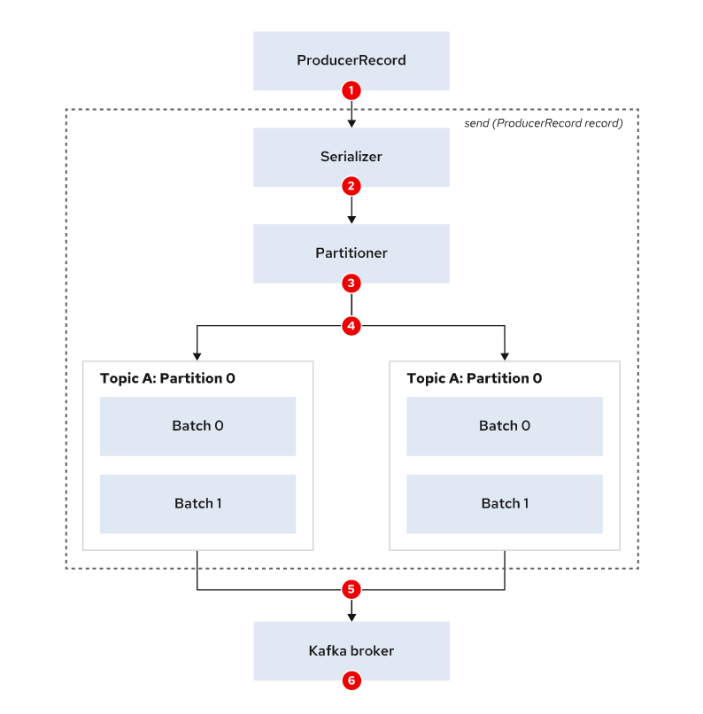
Sending Records to Kafka
The producer creates a record with at least a topic and a value.
The producer serializes the record key, and value.
The producer sends the record to a partitioner. A partitioner is a component of the producer responsible for choosing the partition where the record is sent. (partition field → key → round-robin)
The producer groups records going to the same partition in batches.
Another thread sends the batches of records to the appropriate Kafka brokers.
The broker receives the messages and sends back a response. If the records were written successfully, then the broker sends a response containing topic, partition, and offset. Because several records were sent, the offset starts from the last record written into the topic.
On errors, the producer might retry sending the records if the error is transient and the producer is configured to retry.
Notes:
A batch is a group of records that are sent together to the Kafka broker. Sending individual records to Kafka would lead into a lot of networking traffic and overhead. At the same time, batches are usually compressed for more efficient data transfer and storage

Slide 10
Sending Records to Kafka
ProducerRecord<String, String> record = new ProducerRecord<>(
"topic",
"value"
);
try {
producer.send(record);
} catch (Exception e) {
e.printStackTrace();
}
ProducerRecord<String, String> record = new ProducerRecord<>(
"topic",
"value"
);
try {
producer.send(record).get();
} catch (Exception e) {
e.printStackTrace();
}
private class ProducerCallback implements Callback {
@Override
public void onCompletion(RecordMetadata recordMetadata, Exception e) {
if (e != null) {
e.printStackTrace();
}
}
}
ProducerRecord<String, String> record = new ProducerRecord<>(
"topic",
"value"
);
producer.send(record, new ProducerCallback());
Fire-and-forget
Synchronous
Asynchronous
Notes:
In the 1st code snippet, you create a record without a key. The send method returns a Future object, which is ignored to avoid waiting for a response, ensuring a "Fire-and-Forget" pattern.
Although you can not capture broker errors with this approach, the try/catch block can capture other exceptions (for example, serialization or time out issues).
In the 2nd snippet, you execute get on the Future object returned by the send method. This blocks the current thread until the producer receives a response from the broker.
The 3rd snippet defines a callback that implements the org.apache.kafka.clients.producer.Callback interface. If an error has occurred, then the exception on the onCompletion method will not be null.

Slide 11
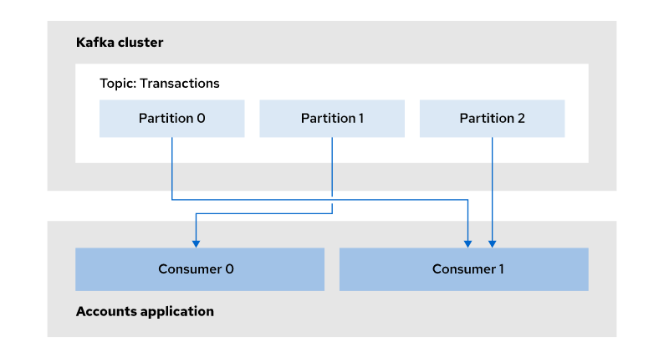
Consumers
Read from one (or more) partition(s)
Gets only “committed” messages (depends on producer “ack” level)
Two modes:
The consumer asks for a specific partition (assign)
An application using one or more consumers has to handle such assignment on its own, the scaling as well
Is member of a consumer group and gets assigned partitions from group lead
Since Kafka 2.4.0, consumers can read from follower replicas (if configured)
Messages might take longer to sync to the follower replicas
Can save costs, optimize network, etc.

Slide 12
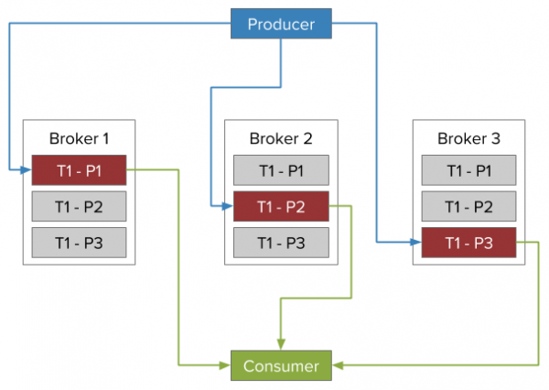

Consuming messages from closest replicas
Producing and consuming messages from leader replica only
Consuming messages from follower replicas
Set broker.rack in broker configuration
Set replica.selector.class → RackAwareReplicaSelector in broker configuration
Set client.rack in client configuration
Notes:
https://developers.redhat.com/blog/2020/04/29/consuming-messages-from-closest-replicas-in-apache-kafka-2-4-0-and-amq-streams#using_the_rack_aware_selector_in_amq_streams

Slide 13
Consumers
Track (commit) the offset for given partition
A partitioned topic “__consumer_offsets” is used for that
Key → [group, topic, partition], Value → [offset]
Offset is shared inside the consumer group
QoS
At most once : read message, commit offset, process message
At least once : read message, process message, commit offset
Exactly once : read message, commit message output and offset to a transactional system (required Transactional API)

Slide 14
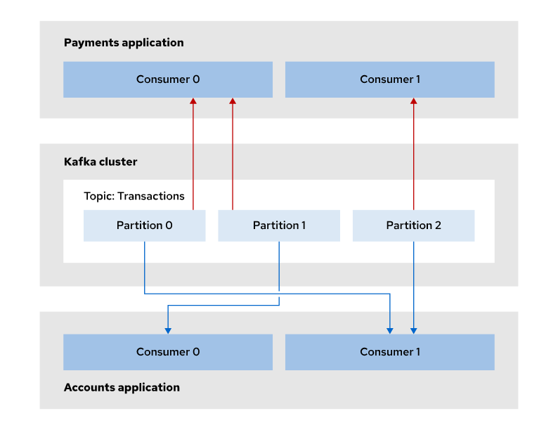
Consumer Groups
The consumer is part of a “consumer group”
Consumer groups are an easy way to scale up consumption
One of the consumers, as “group lead”, applies a strategy to assign partitions to consumers in the group
Group lead election and synchronization is happening through broker and not directly
When new consumers join or leave, a rebalancing happens to reassign partitions
Rebalancing stops all group members, so scaling consumers up and down is not always the best idea
Allows pluggable strategies for partition assignment (e.g. stickiness → partition.assignment.strategy)
https://medium.com/trendyol-tech/rebalance-and-partition-assignment-strategies-for-kafka-consumers-f50573e49609

Slide 15
Consumer Groups
Consumer Group 1
M₀
M₁
M₂
M₃
M₄
M₅
M₆
M
M
M
M
M
M
M
Consumer Group 2
M₀
M₁
M₂
M₃
M₄
M₅
M₆

Slide 16

Consumer Groups
Consumer Group A
Consumer
Topic
Partition 0
Consumer
Partition 1
Consumer Group B
Partition 2
Consumer
Partition 3
Consumer
Consumer

Slide 17

Consumer Groups
Topic
Consumer Group
Partition 0
Consumer
Partition 1
Consumer
Partition 2
Consumer
Partition 3
Consumer
Consumer

Slide 18
Consumer Groups
Consumer Group
Grouping multiple consumers
Each consumer reads from a “unique” subset of partition → max consumers = num partitions
They are “competing” consumers on the topic, each message delivered to one consumer
Messages with same “key” delivered to same consumer
More consumer groups
Allows publish/subscribe
Same messages delivered to different consumers in different consumer groups

Slide 19
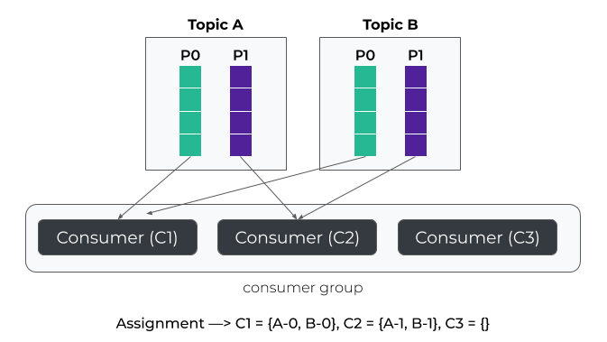

Partition Assignment Strategies
Range
assign the same partition number in every topic to a specific consumer. (order by using the member_id parameter assigned by the broker)
Round Robin
Stricky
Notes:
The partition assignment happens when the consumer joins the group or when another consumer leaves the group. There are several ways in which Kafka can assign partitions to consumers.

Slide 20
Consumer APIs
Consumes messages
Created consumer
Poll for messages
Messages are consumed in batches => iterate through the batch
Deserialize Message
Commit the offsets
No per message acknowledgements
The offset acknowledges all previous messages
Interceptors can be used to intercept and manipulate messages

Slide 21
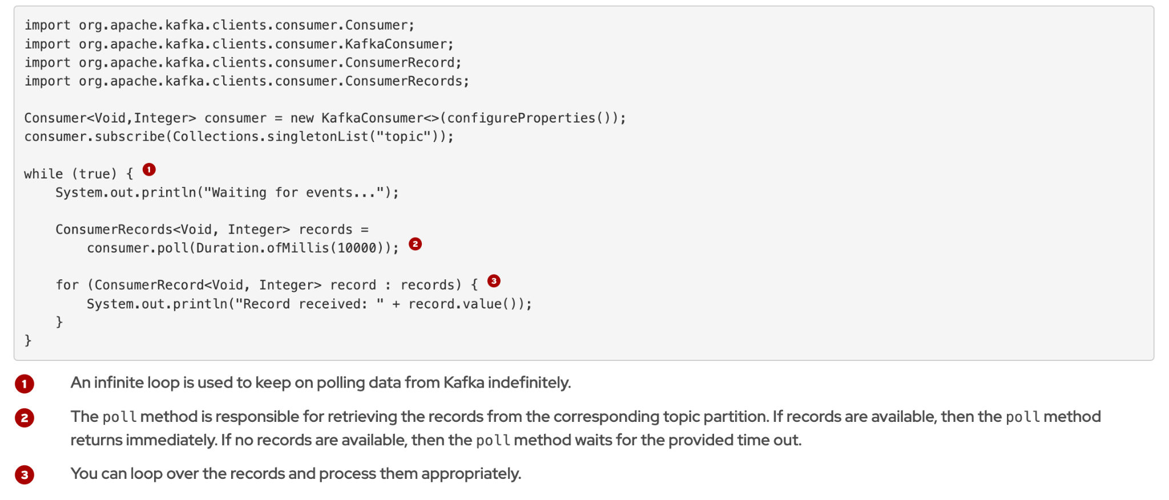
Polling
Consumers receive records in batches.
The maximum number of records in the batch can be configured by setting the max.poll.records consumer property.

Slide 22
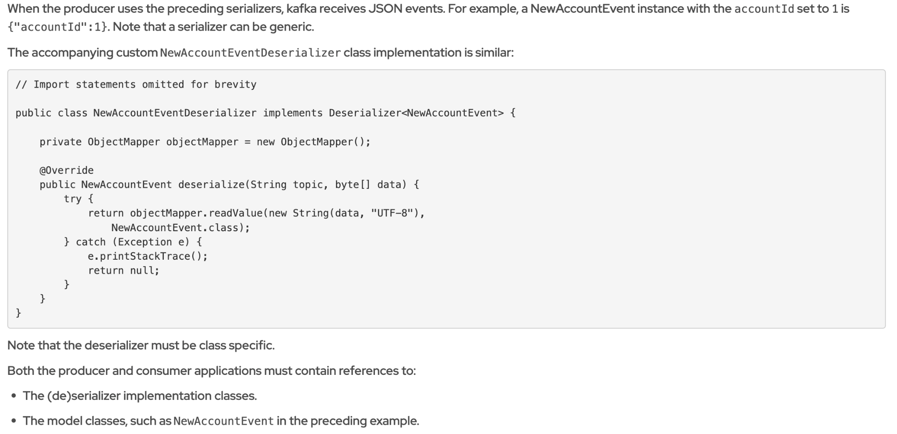
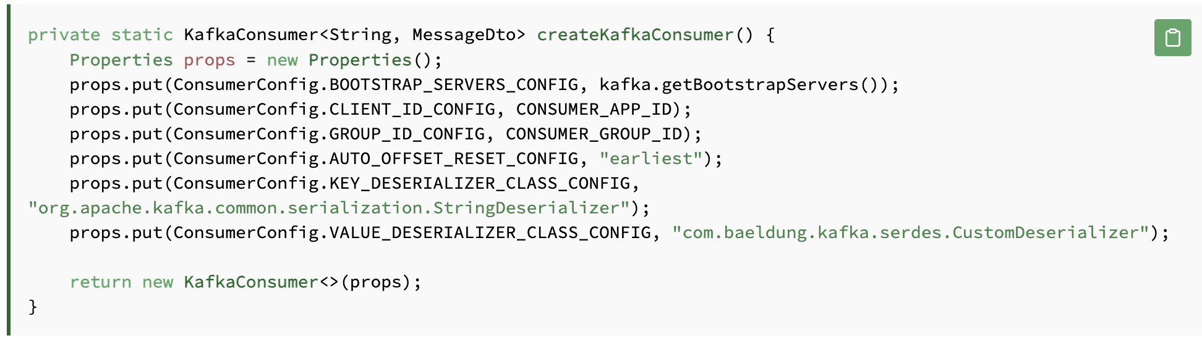
(De)Serializers

Slide 23
Commit Strategies
Auto Commit (enable.auto.commit=true, auto.commit.interval.ms default 5 seconds)
If fails, it throws an exception, it means that it won’t commit anymore
it resumes from the last committed offset
Manual Commit (Trade-offs: latency vs. data consistency)
Sync, synchronous commits and will block until either the commit succeeds
Async, asynchronous call and will not block. Any errors encountered are either passed to the callback (if provided) or discarded.
Kafka message include Topic, partition & offset
Consumer can retrieve from last offset or specific offset position
For reconciliation, consumer can keep message information in persistent (such as database) or reconciliation with offset in kafka

Slide 24
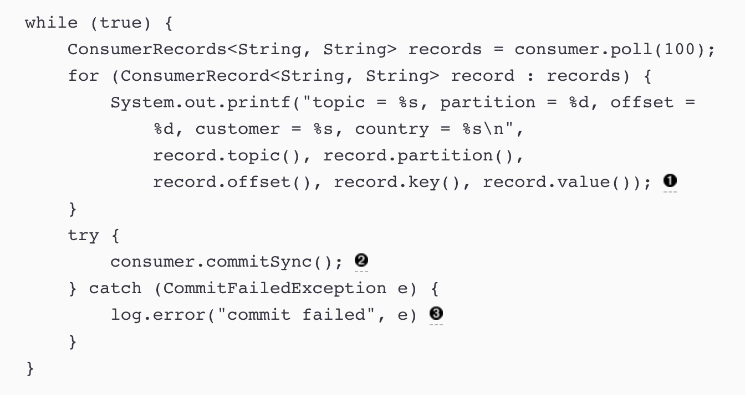
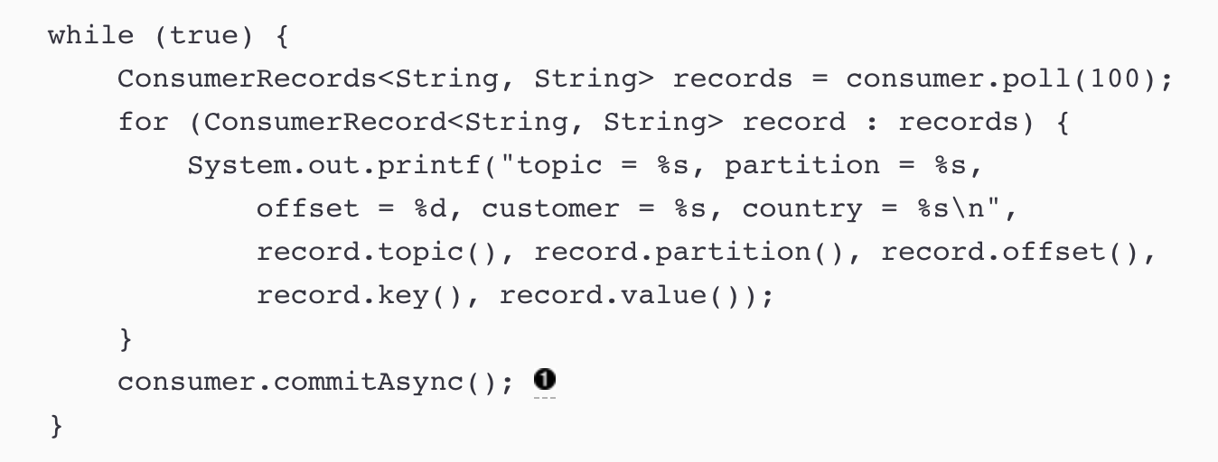
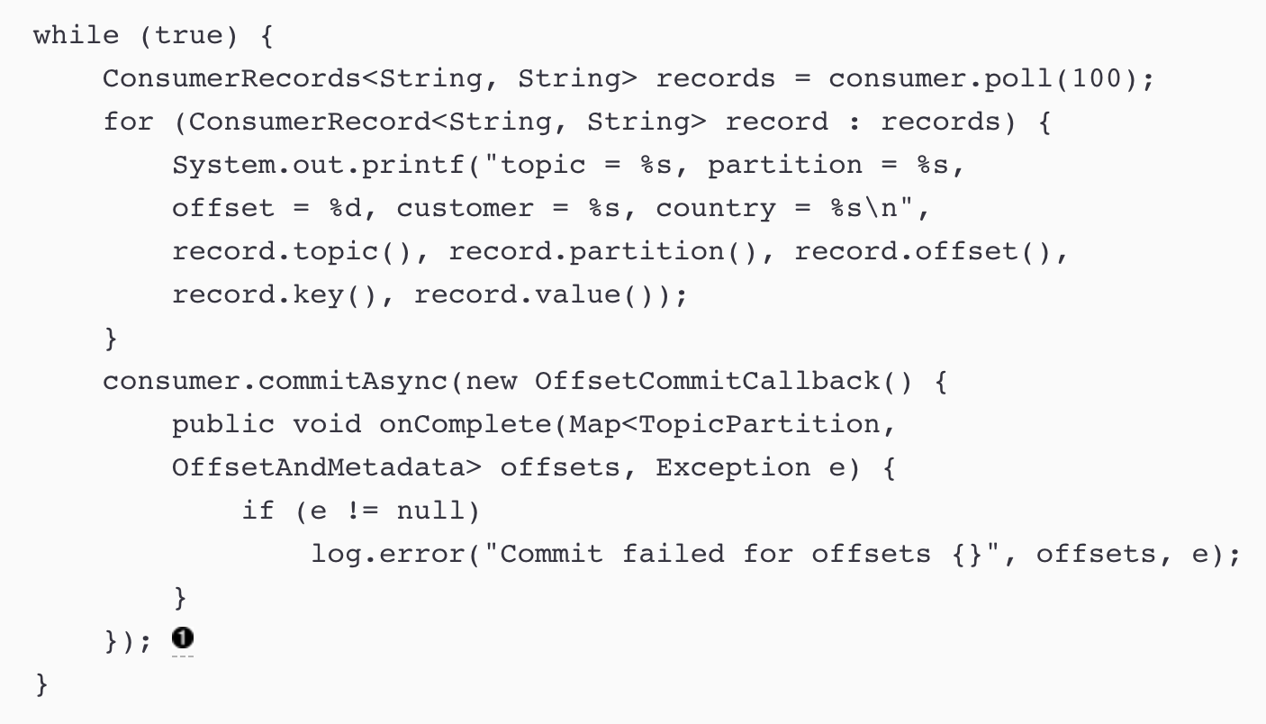
Commit Strategies

Slide 25
Kafka console producer
kafka-console-producer.sh --bootstrap-server localhost:9092 --topic first_topic
To pass in any producer property, such as the acks=all setting
--producer-property acks=all
Produce message with key
--property parse.key=true --property key.separator=:
Produce messages to a topic in a secure cluster
--producer.config client.properties
Example of properties file
security.protocol = SASL_SSL
sasl.mechanism=GSSAPI
sasl.kerberos.service.name = kafka
ssl.truststore.location = /var/private/ssl/kafka.client.truststore.jks
ssl.truststore.password = test1234
sasl.jaas.config=com.sun.security.auth.module.Krb5LoginModule required useTicketCache=true;
Consumer and Producer Utility
Notes:
Since Kafka v0.10, the consumer is leveraging a Kafka connection string, not Zookeeper. This is due to how consumer offsets are stored.

Slide 26
Kafka console consumer
kafka-console-consumer.sh --bootstrap-server localhost:9092 --topic first_topic
To read all historical messages
--from-beginning
To display messages in a particular format
--formatter
To pass in any consumer property, such as the allow.auto.create.topics setting
--consumer-property
By default a random consumer group ID is chosen, but you can override it with this option.
--group
Number of messages to consume before exiting
--max-messages
If you want to only consume from a specific partition.
--partition
Consume messages from a topic in a secure cluster
--consumer.config client.properties
Consumer and Producer Utility

Slide 27
kafka-producer-perf-test for load test producer
kafka-producer-perf-test.sh --topic ssl-perf-test --throughput -1 --num-records 3000000 \
--record-size 1024 --producer-props acks=all bootstrap.servers=broker0:9093,broker1:9093,broker2:9093 \
--producer.config /path/to/ssl-perf-test.properties
Example parameter
--topic : produce messages to this topic
--num-records : number of messages to produce
--throughput : throttle maximum message (messages/sec). Set this to -1 to disable throttling.
--producer-props : kafka producer related configuration properties like bootstrap.servers,client.id etc.
--producer.config : producer config properties file.
--record-size : message size in bytes.
--payload-file : file to read the message payloads from.
Consumer and Producer Utility

Slide 28
kafka-consumer-perf-test for load test consumer
kafka-consumer-perf-test.sh --topic ssl-perf-test --broker-list broker0:9093,broker1:9093,broker2:9093 \
--messages 3000000 --consumer.config /path/to/ssl-perf-test.properties
Example parameter
--bootstrap-server : The broker list string in the form HOST1:PORT1,HOST2:PORT2.
--consumer.config : Consumer config properties file.
--group : The group id to consume on.
--messages: The number of messages to send or consume
--topic : The topic to consume from.
Consumer and Producer Utility

Slide 29
Thank you
AMQ Streams Enablement training 2020

